Slide 1
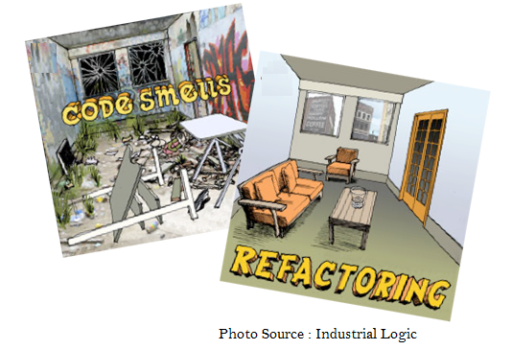
Clean Code, Code Smells & Refactoring
Zohirul Alam Tiemoon
CEO, Nerd Castle Ltd.

Slide 2
Clean code?
Clean code is code that is easy to understand and easy to change.
Clean code is easy to read and maintain.
Clean code is not redundant.
Clean code contains a minimal number of classes and other moving parts.

Slide 3
Clean code?
“Any fool can write code that a computer can understand. Good programmers write code that humans can understand”
— Martin Fowler
“Programming is the art of telling another human what one wants the computer to do” — Donald Knuth

Slide 4
Clean code
Which one is cleaner?
if (date.before (SUMMER_START) || date.after(SUMMER_END))
charge = quantity * winterRate + winterServiceCharge;
else
charge = quantity * summerRate;
if (notSummer(date))
charge = winterCharge(quantity);
else
charge = summerCharge (quantity);

Slide 5
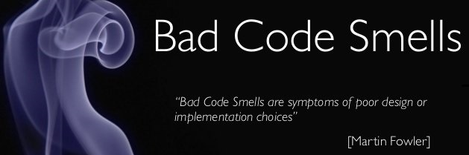

Code Smells?
In computer programming, code smell is any symptom in the source code of a program that possibly indicates a deeper problem. Code smells are usually not bugs—they are not technically incorrect and do not currently prevent the program from functioning. Instead, they indicate weaknesses in design that may be slowing down development or increasing the risk of bugs or failures in the future.
A code smell is a design that duplicates, complicates or tightly-coupled code

Slide 6
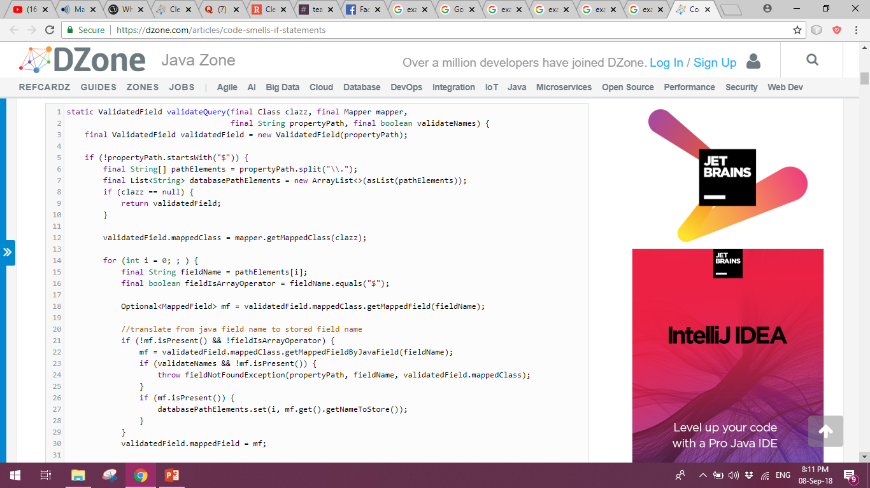
Code Smells (Example)

Slide 7
Refactoring?
"Refactoring is the process of changing a software system in such a way that it does not alter the external behavior of the code yet improves its internal structure."
– Martin Fowler

Slide 8
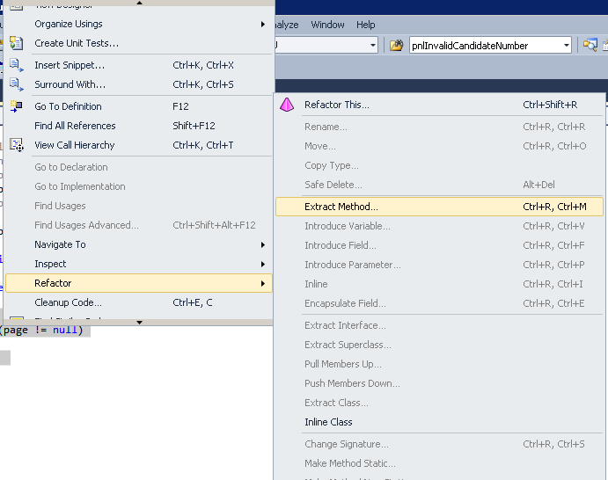
Refactoring?
Visual Studio

Slide 9
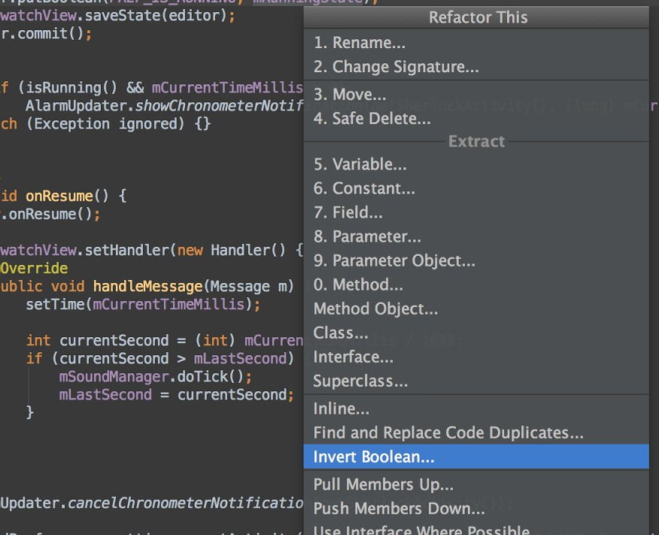
Refactoring?
Android Studio

Slide 10
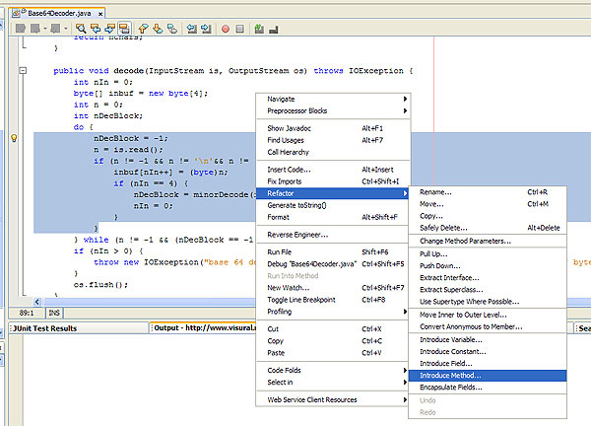
Refactoring?
NetBeans

Slide 11
When??
Refactoring
If it stinks, change it!
The cheapest time to refactor code is right now.

Slide 12

Common Code Smells
Inappropriate naming
Comments
Dead code
Duplicated code
Primitive obsession
Large class
God class
Lazy class
Middle man
Data clumps
Data class
Long method
Long parameter list
Switch statements
Speculative generality
Oddball solution
Feature envy
Refused bequest
Black sheep
Contrived complexity
Divergent change
Shotgun Surgery

Slide 13
Inappropriate Naming
Names given to variables (fields) ,methods or class should be clear and meaningful.
A variable, field, class name should say exactly what it is.
Which is better?
private string s; OR private string salary;
A method should say exactly what it does.
Which is better?
public double calc (double s);
OR
public double calculateFederalTaxes (double salary);
Remedy:
Rename Variables, Fields, Methods, Classes

Slide 14
Long Method
A method is long when it is too hard to quickly comprehend.
Long methods tend to hide behavior that ought to be shared, which leads to duplicated code in other methods or classes.
Good OO code is easiest to understand and maintain with shorter methods with good names
Remedies:
Extract Method
Replace Temp with Query
Introduce Parameter Object
Preserve Whole Object
Replace Method with Method Object.
Decompose Conditional

Slide 15
Long Method (Example)
private String toStringHelper(StringBuffer result) {
result.append("<");
result.append(name);
result.append(attributes.toString());
result.append(">");
if (!value.equals(""))
result.append(value);
Iterator it = children().iterator();
while (it.hasNext()) {
TagNode node = (TagNode)it.next();
node.toStringHelper(result);
}
result.append("</");
result.append(name);
result.append(">");
return result.toString();
}

Slide 16
Extract Method
Remedy of Long method
private String toStringHelper(StringBuffer result) {
writeOpenTagTo(result);
writeValueTo(result);
writeChildrenTo(result);
writeEndTagTo(result);
return result.toString();
}
private void writeOpenTagTo(StringBuffer result) {
result.append("<");
result.append(name);
result.append(attributes.toString());
result.append(">");
}
private void writeValueTo(StringBuffer result) {
if (!value.equals(""))
result.append(value);
}
private void writeChildrenTo(StringBuffer result) {
Iterator it = children().iterator();
while (it.hasNext()) {
T agNode node = (TagNode)it.next();
node.toStringHelper(result);
}
}
private void writeEndTagTo(StringBuffer result)
{
result.append("</");
result.append(name);
result.append(">");
}

Slide 17
Replace Temp with Query
Remedy of Long method
double basePrice = _quanity * _itemPrice;
if(basePrice > 1000)
{
return basePrice * 0.95;
}
else
{
return basePrice * 0.98;
}
if(getBasePrice() > 1000) {
return getBasePrice() * 0.95;
}
else {
return getBasePrice() * 0.98;
}
double getBasePrice() {
return _quanitiy * _itemPrice;
}

Slide 18
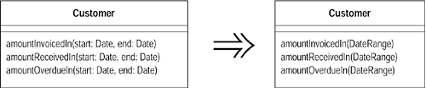
Introduce Parameter Object
Remedy of Long method

Slide 19
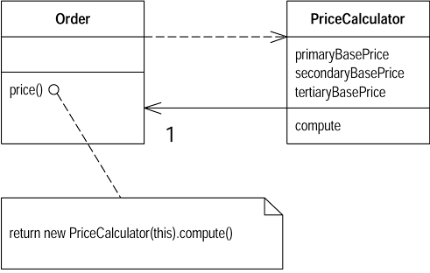
Replace Method with Method Object
Remedy of Long method
//class Order...
double price() {
double primaryBasePrice;
double secondaryBasePrice;
double tertiaryBasePrice;
// long computation;
...
}

Slide 20
Decompose Conditional
Remedy of Long method
You have a complicated conditional (if-then-else) statement. Extract methods from the condition, then part, and else parts.
if (date.before (SUMMER_START) || date.after(SUMMER_END))
charge = quantity * _winterRate + _winterServiceCharge;
else charge = quantity * _summerRate;
---------------------------------------------------------------------------------------------
if (notSummer(date))
charge = winterCharge(quantity);
else charge = summerCharge (quantity);

Slide 21
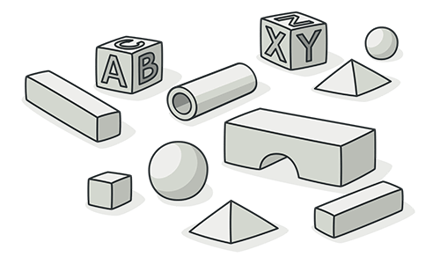
Primitive Obsession
Use of primitives instead of small objects for simple tasks

Slide 22
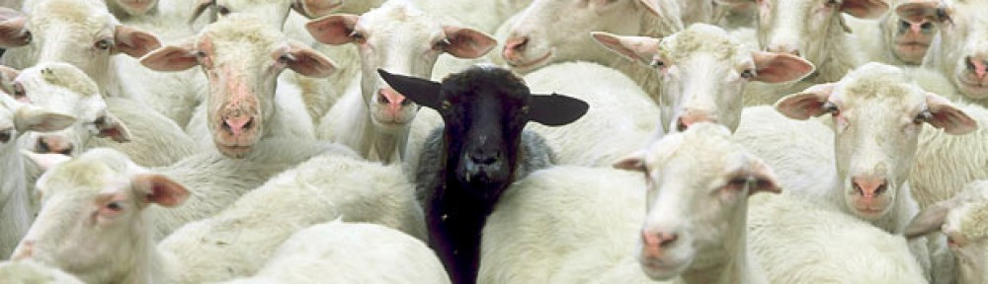
Black Sheep
Sometimes a subclass or method doesn't fit in so well with its family.
A subclass that is substantially different in nature than other subclasses in the hierarchy.
A method in a class that is noticeably different from other methods in the class.
Remedy
Move Method
Extract Class

Slide 23
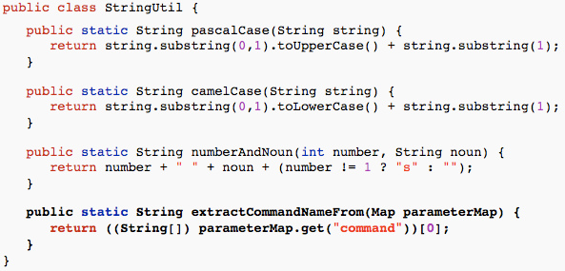
Black Sheep (Example)

Slide 24

Feature Envy
A method that seems more interested in some other class than the one it is in data and behavior that acts on that data belong together.
When a method makes too many calls to other classes to obtain data or functionality, Feature Envy is in the air.
Remedies:
Move Field
Move Method
Extract Method

Slide 25
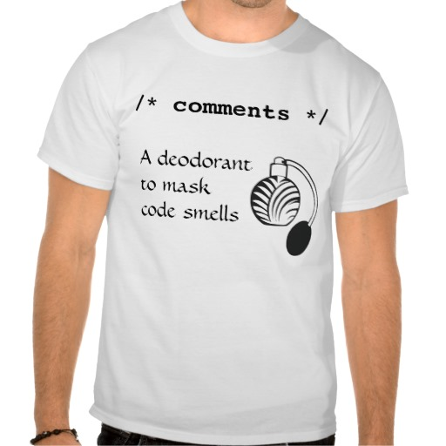
Comments
Comments are often used as deodorant
Comments represent a failure to express an idea in the code. Try to make your code self-documenting or intention-revealing
When you feel like writing a comment, first try to refactor it.
Remedy:
Extract Method
Rename Method

Slide 26
Comments (Cont’d)
void List::add(string element)
{
if (!m_readOnly)
{
int newSize = m_size + 1;
if (newSize > getCapacity())
{
// grow the array
m_capacity += INITIAL_CAPACITY;
string* elements2 = new string[m_capacity];
for (int i = 0; i < m_size; i++)
elements2[i] = m_elements[i];
delete[] m_elements;
m_elements = elements2;
}
m_elements[m_size++] = element;
}

Slide 27
Comments (Cont’d)
void List::add(string element)
{
if (m_readOnly)
return;
if (shouldGrow())
grow();
storeElement(element);
}
bool List::shouldGrow()
{
return (m_size + 1) > capacity();
}
void List::grow()
{
m_capacity += 10;
string *newElements = new string[m_capacity];
for(int i = 0;i < m_size;i++)
newElements[i] = m_elements[i];
delete [] m_elements;
m_elements = newElements;
}
void List::storeElement(string element)
{
m_elements[m_size++] = element;
}

Slide 28
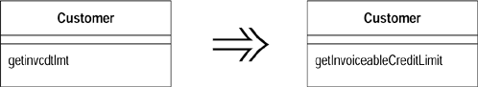
Rename Method
Remedy of Comments

Slide 29
Extract Method
Remedy of Comments
void PrintOwning(double amount){
PrintBanner();
/ / print details
System.Console.Out.WriteLine(“name: “+ name);
System.Console.Out.WriteLine(“amount: “+ amount);
}
void PrintOwning(double amount){
PrintBanner();
PrintDetails(amount);
}
void PrintDetails(double amount){
System.Console.Out.WriteLine(“name: “+ name);
System.Console.Out.WriteLine(“amount: “+ amount);
}

Slide 30
Lazy Class
A class that isn't doing enough to carry its weight. We let the class die with dignity
Remedies
Inline Class
Collapse Hierarchy

Slide 31
Lazy Class (Cont’d)
public class Letter {
private final String content;
public Letter(String content) {
this.content = content;
}
public String getContent() {
return content;
}
}

Slide 32
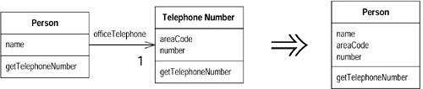
Inline Class
Remedy of Lazy Class

Slide 33
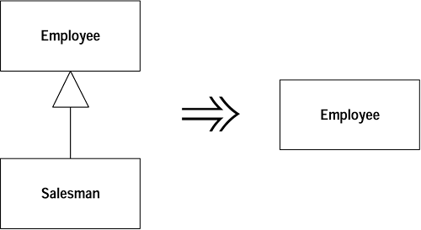
Collapse Hierarchy
Remedy of Lazy Class

Slide 34
Speculative Generality
You get this smell when people say "Oh, I think we will need the ability to do that someday" and thus want all sorts of hooks and special cases to handle things that aren't required.
This odor exists when you have generic or abstract code that isn’t actually needed today. Such code often exists to support future behavior, which may or may not be necessary in the future.
Remedy
Collapse Hierarchy
Inline Class
Remove Parameter
Rename Method

Slide 35
Speculative Generality (Cont’d)
public class Customer {
private String name;
private String address;
private String salutation;
private String otherDetails;
private MailingSystem mailingSystem;
public Customer(String name, String salutation, String add, String details, MailingSystem mSys) {
this.name = name;
this.address = add;
this.salutation = salutation;
this.otherDetails = details;
this.mailingSystem = mSys;
}
String getName() {
return name;
}
MailingSystem getMailingSystem() {
return mailingSystem;
}
}

Slide 36
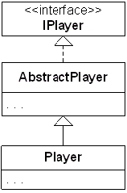
Speculative Generality (Cont’d)

Slide 37
Collapse Hierarchy
Remedy of Speculative Generality

Slide 38
Inline Class
Remedy of Speculative Generality

Slide 39
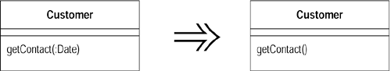
Remove Parameter
Remedy of Speculative Generality

Slide 40

Dead Code
Code that is no longer used in a system or related system is Dead Code.
Increased Complexity.
Accidental Changes.
More Dead Code
Remedy

Slide 41
Dead Code (Cont’d)
One of the following constructors is never called by a client. It is dead code.
public class Loan {
public Loan(double commitment, int riskRating, Date maturity, Date expiry) {
this(commitment, 0.00, riskRating, maturity, expiry);
}
public Loan(double commitment, double outstanding, int customerRating, Date maturity, Date expiry) {
this(null, commitment, outstanding, customerRating, maturity, expiry);
}
public Loan(CapitalStrategy capitalStrategy, double commitment, int riskRating, Date maturity, Date expiry) {
this(capitalStrategy, commitment, 0.00, riskRating, maturity, expiry);
}
...
}

Slide 42

Refused Bequest
This potent odor results when subclasses inherit code that they don’t want. In some cases, a subclass may “refuse the bequest” by providing a do nothing implementation of an inherited method.
Remedy
Push Down Field/Method
Replace Inheritance with Delegation

Slide 43
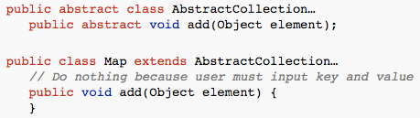
Refused Bequest (Cont’d)

Slide 44
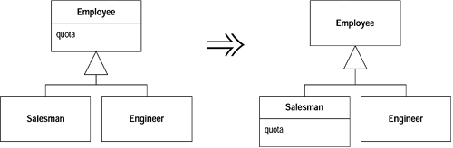
Push Down Method
Remedy of Refused Bequest

Slide 45
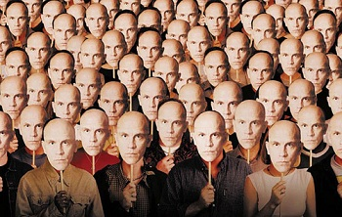
Duplicate Code
The most pervasive and pungent smell in software
There is obvious or blatant duplication such as copy and paste
There are subtle or non-obvious duplications
> Such as parallel inheritance hierarchies.
> Similar algorithms
Remedy
Extract Method
Pull Up Field
Substitute Algorithm

Slide 46
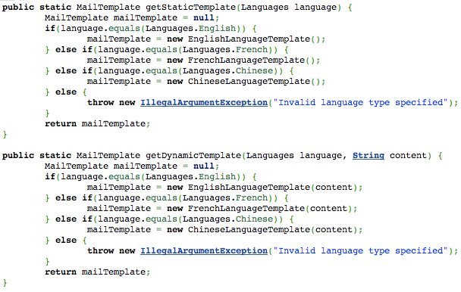
Duplicate Code (Cont’d)
Ctl+C Ctl+V Pattern

Slide 47
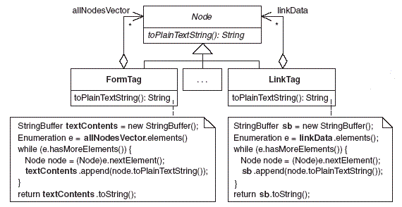
Duplicate Code (Cont’d)

Slide 48
Duplicate Code (Cont’d)
public int addCustomer( int userId, Customer newCustomer) {
List<Customer> customerList = customers.get(userId);
int customerId = (int) Math.random() * 1000;
// TODO: Logic to find/generate customer id.
newCustomer.setId(customerId);
if (customerList == null) {
customerList = new LinkedList<Customer>();
customers.put(userId, customerList);
}
customerList.add(newCustomer);
return customerId;
}
public int addTemplate( int userId, Template newTemplate) {
List<Template> templateList = templates.get(userId);
int templateId = (int) Math.random() * 1000;
// TODO: Logic to find/generate template id.
newTemplate.setId(templateId);
if (templateList == null) {
templateList = new LinkedList<Template>();
templates.put(userId, templateList);
}
templateList.add(newTemplate);
return templateId;
}

Slide 49
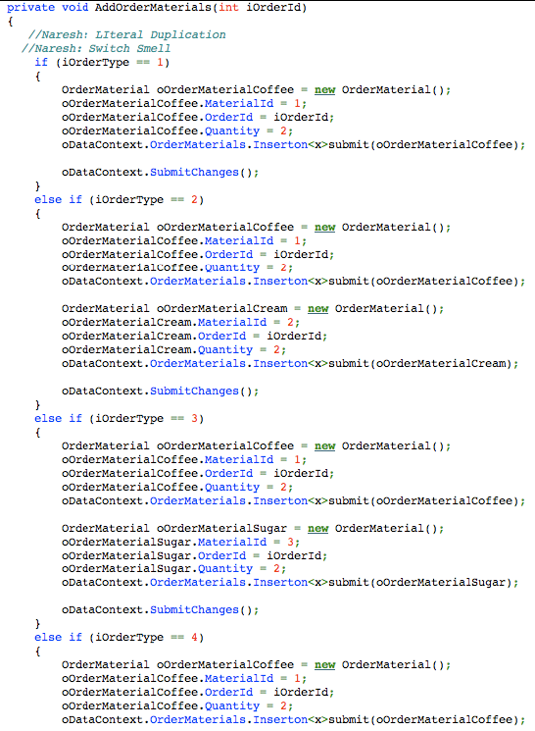
Duplicate Code (Cont’d)

Slide 50
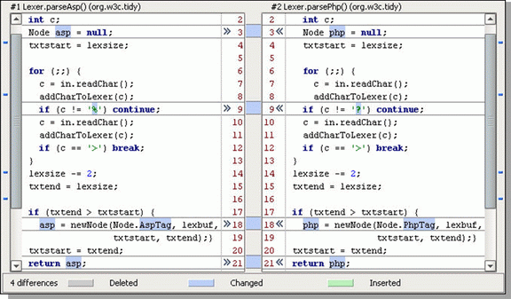
Literal Semantic Data Duplication Conceptual
Duplicate Code (Cont’d)
Levels of Duplication

Slide 51
Literal Duplication
Duplicate Code (Cont’d)
Same for loop in 2 places

Slide 52
Semantic Duplication
Duplicate Code (Cont’d)
1st Level - For and For Each Loop
2nd Level - Loop v/s Lines repeated
3rd Level - Loop v/s Recursion
stack.push(1);
stack.push(3);
stack.push(5);
stack.push(10);
stack.push(15);
v/s
for(int i : asList(1,3,5,10,15))
stack.push(i);

Slide 53
Data Duplication
Duplicate Code (Cont’d)
Some constant declared in 2 classes (test and production)

Slide 54
Conceptual Duplication
Duplicate Code (Cont’d)
Two Algorithms to Sort elements (Bubble sort and Quick sort)

Slide 55
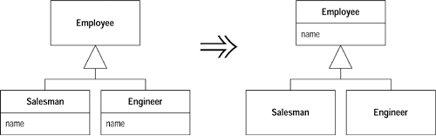
Pull Up Field
Remedy of duplicate code

Slide 56
Substitute Algorithm
Remedy of duplicate code
String foundPerson(String[] people){
for (int i = 0; i < people.length; i++) {
if (people[i].equals ("Don")){
return "Don";
}
if (people[i].equals ("John")){
return "John";
}
if (people[i].equals ("Kent")){
return "Kent";
}
}
return "";
}
String foundPerson(String[] people){
List candidates = Arrays.asList(new String[]
{"Don", "John", "Kent"});
for (String person : people)
if (candidates.contains(person))
return person;
return "";

Slide 57
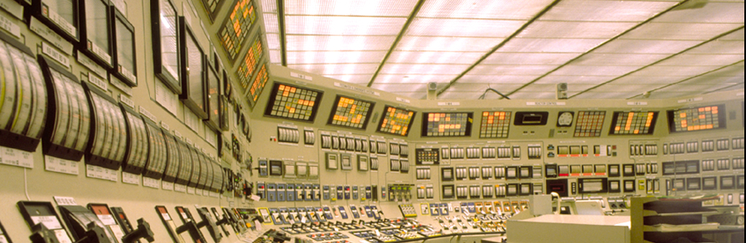
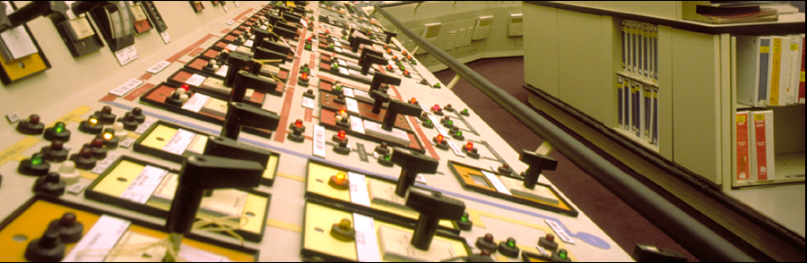
Switch Statement
This smell exists when the same switch statement (or “if…else if…else if”
statement) is duplicated across a system.
Such duplicated code reveals a lack of object-orientation and a missed
opportunity to rely on the elegance of polymorphism.
Remedy:
Replace Type Code with Polymorphism
Replace Type Code with State / Strategy
Introduce Null Object.

Slide 58
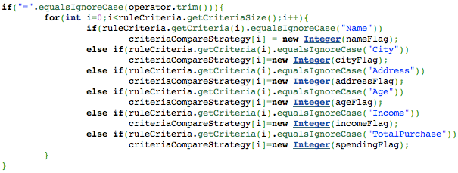
Switch Smell (Cont’d)

Slide 59
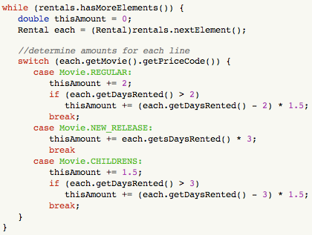
Switch Smell (Cont’d)

Slide 60
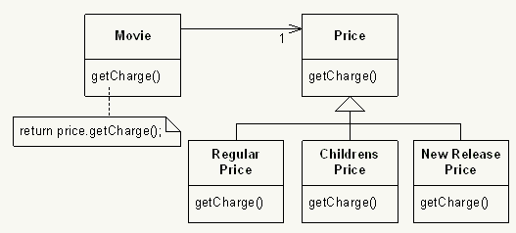
Replace Type Code with Polymorphism
Remedy of Switch Smell

Slide 61
Replace Parameter with Method
Remedy of Switch Smell
void setValue (String name, int value) {
if (name.equals("height"))
this.height = value;
if (name.equals("width"))
this.width = value;
}
void setHeight(int h) {
this.height = h;
}
void setWidth (int w) {
this.width = w;
}

Slide 62
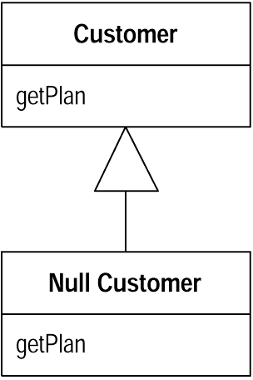
Introduce Null Object
Remedy of Switch Smell
// In client class
Customer customer = site.getCustomer();
BillingPlan plan;
if (customer == null) plan = BillingPlan.basic();
else plan = customer.getPlan();
// In client class
Customer customer = site.getCustomer();
BillingPlan plan = customer.getPlan();
// In Null Customer
public BillingPlan getPlan(){
return BillingPlan.basic();
}

Slide 63
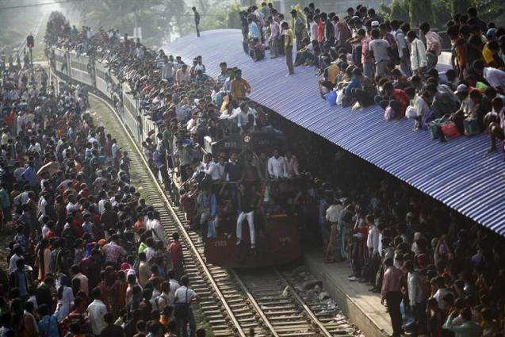
Large Class
Like people, classes suffer when they take on too many responsibilities.
GOD Objects
Fowler and Beck note that the presence of too many instance variables usually indicates that a class is trying to do too much. In general, large classes typically contain too many responsibilities.
Remedies
Extract Class
Replace Type Code with Class/Subclass
Replace Type Code with State/Strategy
Replace Conditional with Polymorphism
Extract Interface

Slide 64
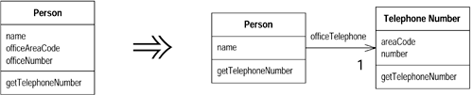
Extract Class

Slide 65
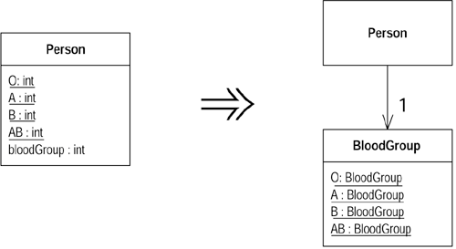
Replace Type Code with Class

Slide 66
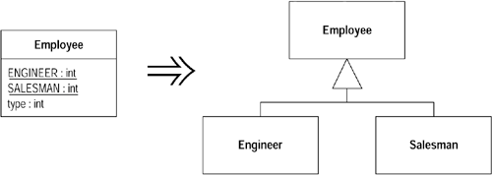
Replace Type Code with Subclasses

Slide 67
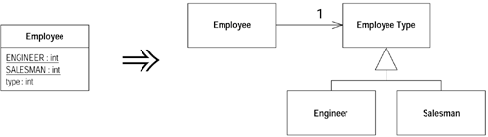
Replace Type Code with State/Strategy

Slide 68

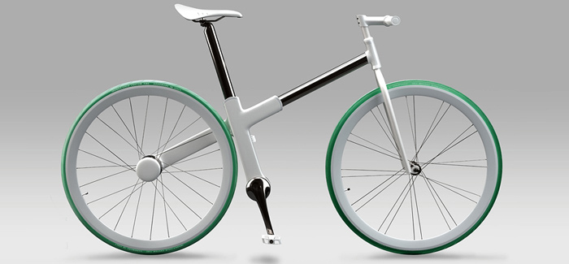
Contrived complexity
Forced usage of overly
complicated design
patterns where simpler
design would suffice.
“Any intelligent fool can make things bigger, more complex, and more violent. It takes a touch of genius…and a lot of courage to move in the opposite direction.” ~ E.F. Schumacher

Slide 69
Data clumps
Sometimes different parts of the code contain identical groups of variables (such as parameters for connecting to a database). These clumps should be turned into their own classes.
Remedy: Extract class

Slide 70
Temporary fields
Class has a variable which is only used in some situation (inside one/two methods).
Remedy
Move field
Extract Class

Slide 71
Acknowledgements
Martin Fowler
Kent Beck
Naresh Jain
Ron Jeffries
Robert C. Martin
Industrial Logic
Thought Works

Slide 72


Slide 73
